Slide 1
Famous and fabulous buses from fact and fiction.
Famous and fabulous buses from fact and fiction.
Buses are brilliant!
They have played in an important part in national and worldwide history, as well as in stories.
Jump aboard and find out more!

Slide 2
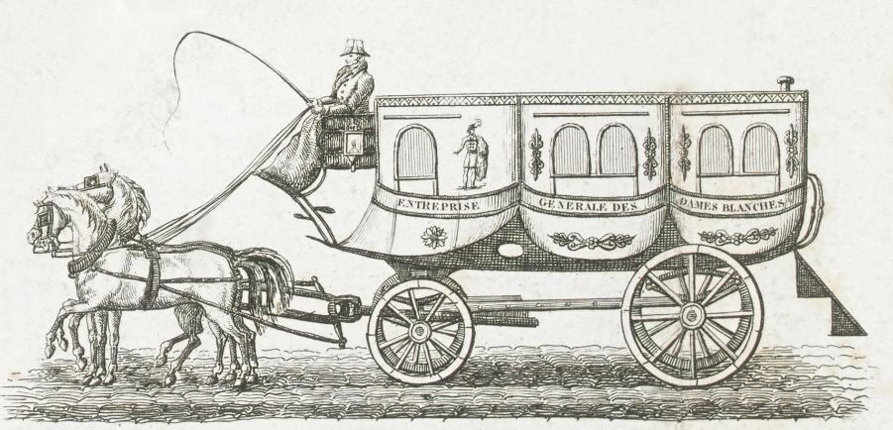
Stanislas Baudry Omnibus
The first public bus system was introduced in Nantes, France, by Stanislas Baudry in 1826.
These omnibuses (from the latin meaning, 'for all') were horse-drawn carriages that could carry up to 16 passengers.
Find out more about the history of buses at
https://artsandculture.google.com/story/a-brief-history-of-buses/vQVBCgQMbTStvg?hl=en

Slide 3
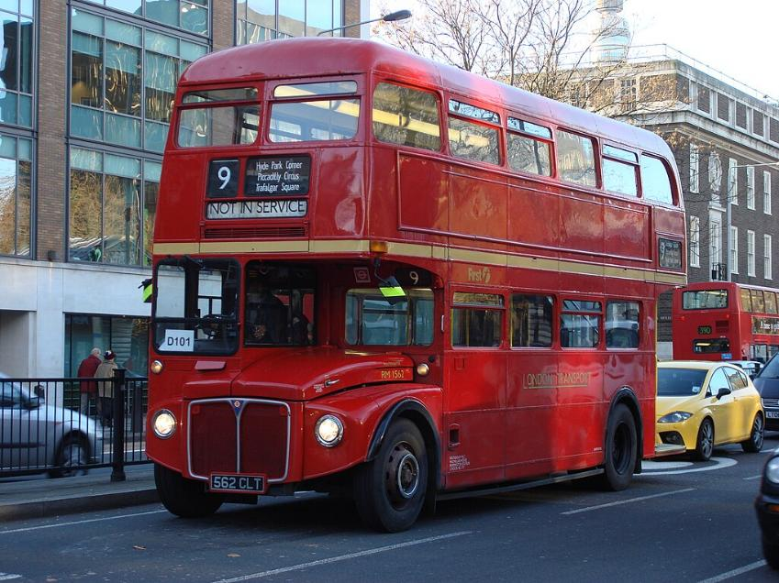
London Bus
These iconic red buses have become a symbol of the city of London.
These buses are part of the public transport system and can be used by anyone, not just tourists.
Find out why London buses are red at:
https://www.ltmuseum.co.uk/collections/stories/transport/why-are-london-buses-red

Slide 4
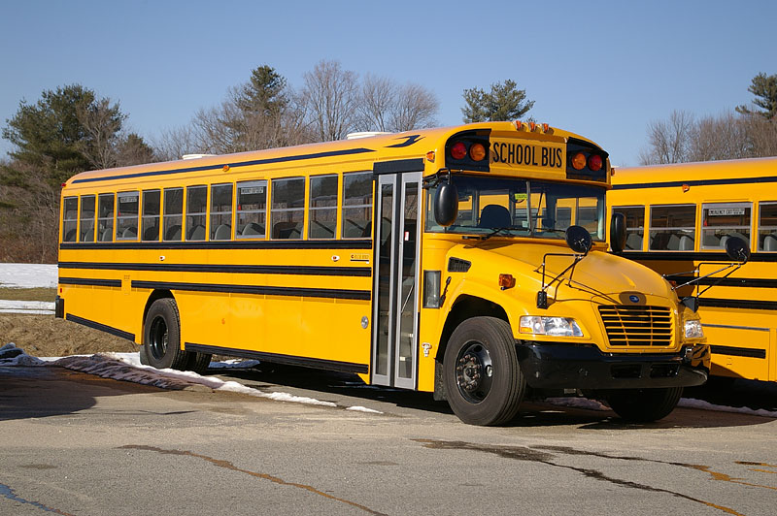
Yellow School Bus
The yellow school bus is a common sight in the United States and Canada.
The yellow colour and black colouring is designed to help make the bus be more easily seen by other drivers, especially in the early morning and late afternoon, to improve the safety of the children being transported.
Find out how yellow school buses became a symbol of America life at:
https://www.bbc.co.uk/bitesize/articles/ztj4qyc

Slide 5
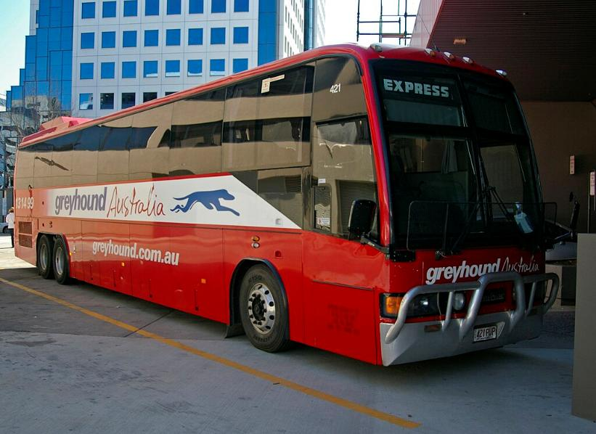
Greyhound Bus
The greyhound bus is a popular service used by tourists to travel around Australia.
Greyhound buses also operate in USA, Canada and Mexico, but they are not part of the same company as Greyhound Australia.
Find out more about the real greyhound bus greyhound
https://greytarticles.wordpress.com/historical/when-greyhound-bus-had-a-real-greyhound/

Slide 6
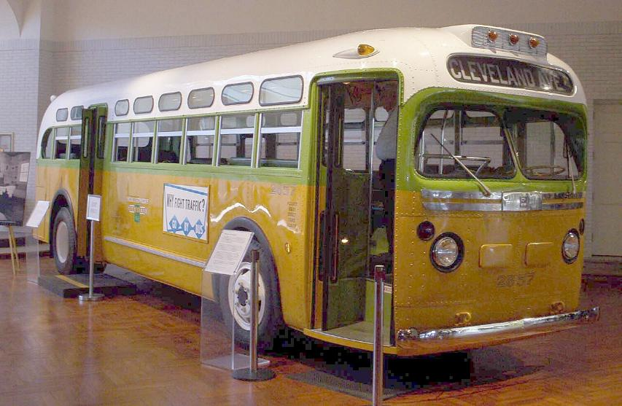
Alabama City Bus
In 1955 Rosa Parks was arrested for refusing to give up her seat on a bus to a white man.
This led to a protest with people refusing to travel by bus until laws were changed to make sure people are treated fairly whatever the colour of their skin.
Find out more about the life of Rosa Parks:
https://www.bbc.co.uk/teach/class-clips-video/articles/z7rtvk7

Slide 7
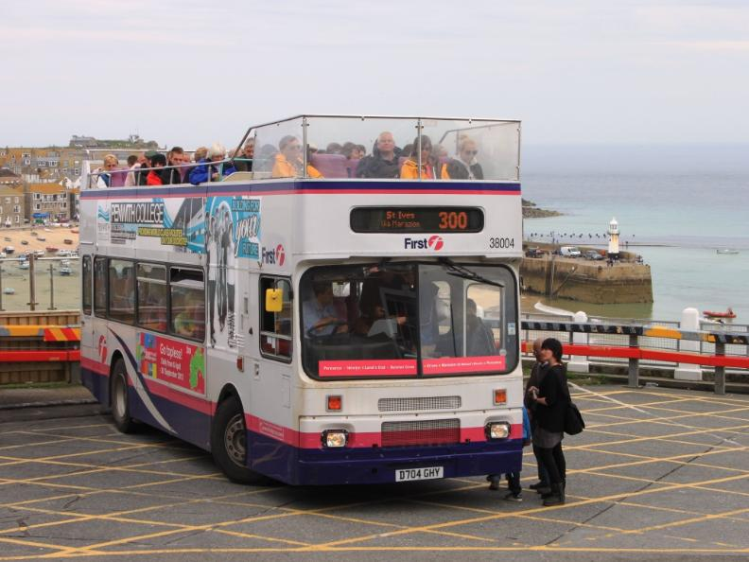
Open Top Bus
An open top bus is a bus, usually a double decker, which been built or changed to operate without a roof.
Open top buses are used for sightseeing and during celebration victory parades.
Are there any sightseeing buses in the town, city or countryside where you live?

Slide 8
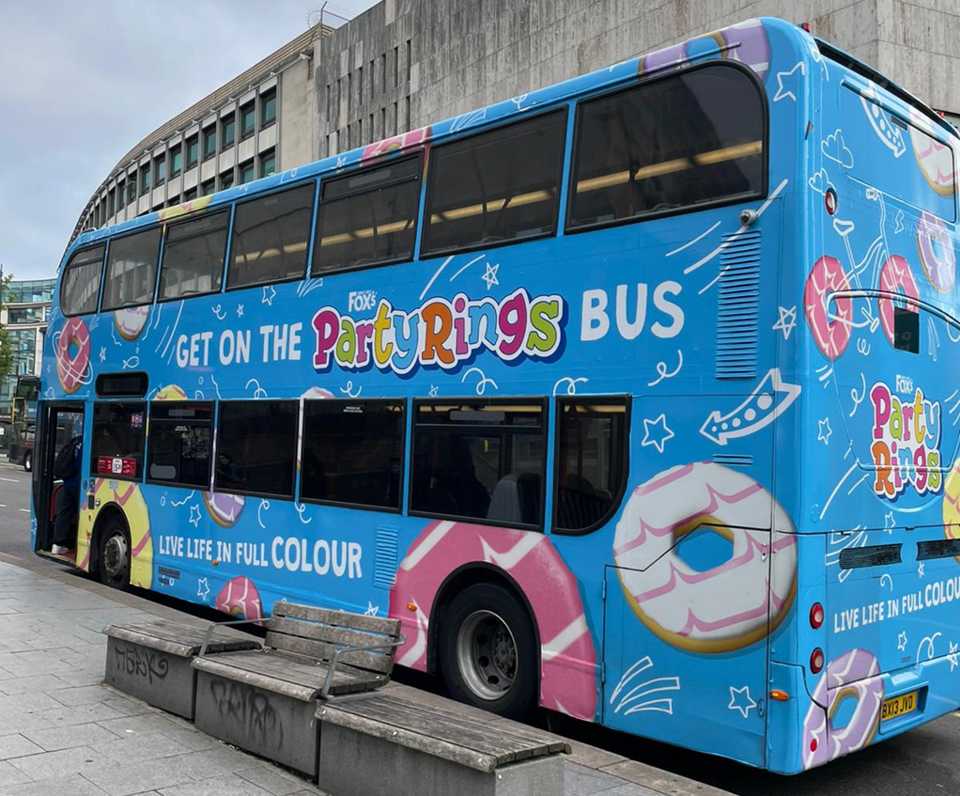
Party Bus
A bus that has been converted into a venue for an exhibition or event.
Perhaps for a party, a gallery, or even a library.
Can you design a bus, both inside and out, for a celebration?

Slide 9
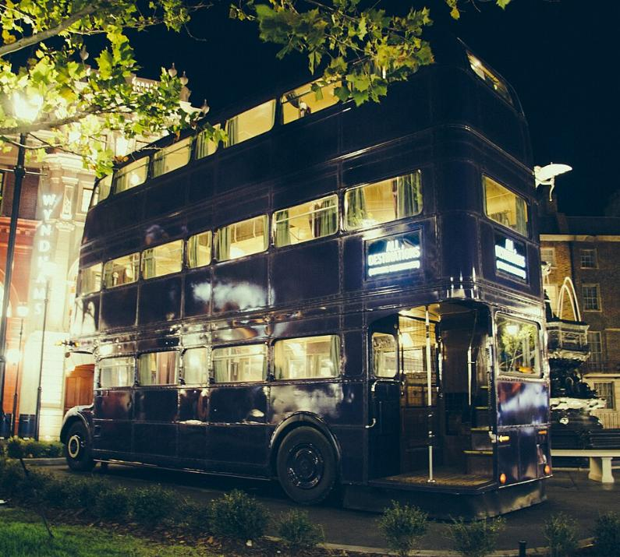
Knight Bus
The Knight Bus is a magical, triple-decker, purple bus from the Harry Potter stories.
The Knight Bus provides fast transportation for witches and wizards.
Can you design a magical bus for elves, fairies and pixies?

Slide 10
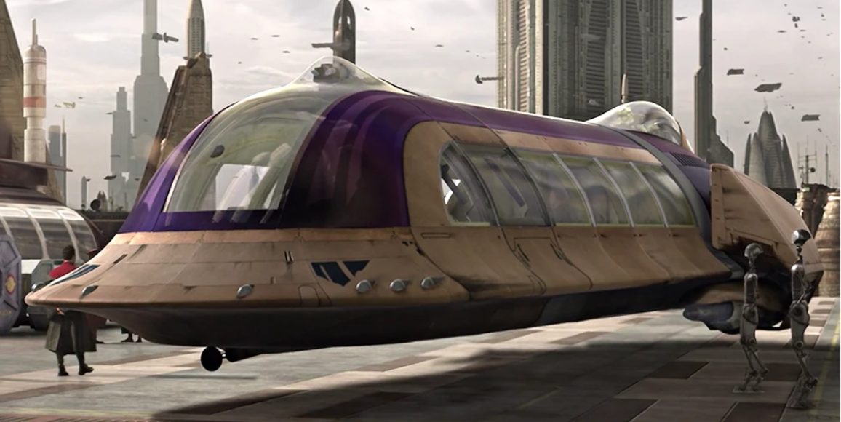
Jedi Shuttle Bus
Even in a galaxy far, far away, public transport is needed by droids, aliens and jedi knights to travel around their planet.
How do you imagine buses might look in the future?

Slide 11
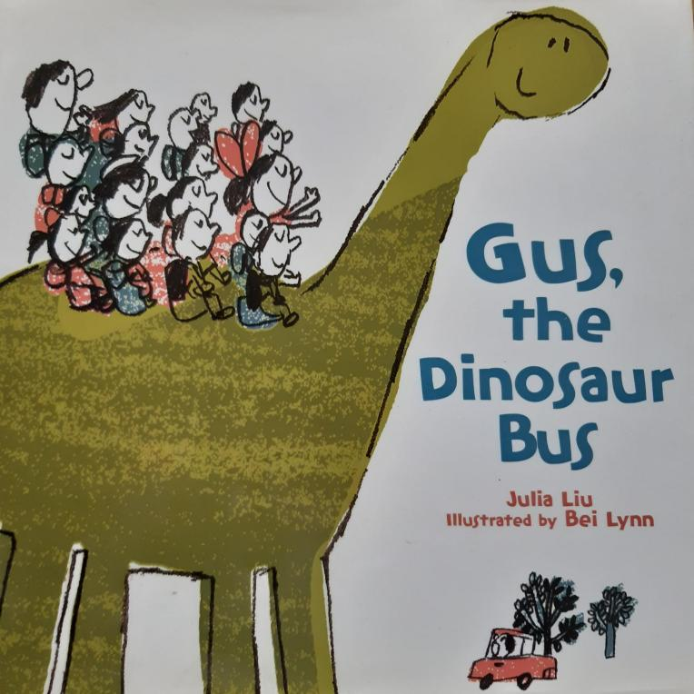
Gus, the Dinosaur Bus
A story by Julia Liu, illustrated by Bei Lynn, in which children travel to school by dinosaur!
If you could ride any animal to school with your friends, what would it be?

Slide 12
Explore more about buses and share what you discover!
Explore more about buses and share what you discover!
Create a PowerPoint with more fun facts about buses.
Make a simple fold slit book to illustrate a story or non-fiction book about buses.
Look out for different types of buses and find out what places you can travel to by bus near you.
You can even share your bus photos, drawing, stories and fun facts with us at
https://www.facebook.com/travelsmartderbyshire
https://x.com/Be_Travel_Smart

