Slide 1

Travel Smart Tales
Travel Smart Tales
Join the SMILERS for an adventure to explore books about journeys that celebrate being Travel Smart
and which boost your wellbeing, as well as helping to reduce
traffic jams and pollution too!
18th to 22nd May 2026
Each day of
Travel Smart Week find out more about one of the
ways to wellbeing and try to spot the books and stories about different ways of travelling!

Slide 2
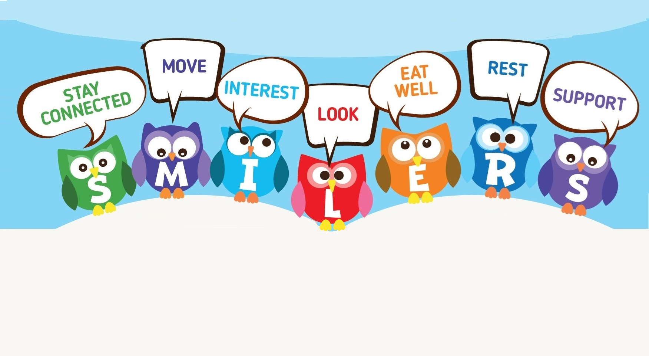
Ways to Wellbeing.
Stay Connected. Having healthy relationships with people, pets and nature to help you to feel happy.
Move. Being active releases chemicals in your brain which boosts your mood and makes you feel good.
Interest. Having special interests and learning something new to help keep your brain busy.
Look. Using your senses to notice what is around you to keep you in the moment.
Eat well. Eating a balanced diet to make you feel good and help you stay healthy and strong.
Rest. Getting a good night’s sleep to improve your memory, mood and mental health.
Support. Supporting others to make us feel positive and to make them happy too!

Slide 3

Ways to make your journey
Ways to make your journey.
WALK
BUS
WHEEL
CARSHARE
SCOOT
PARK AND
CYCLE
STRIDE

Slide 4
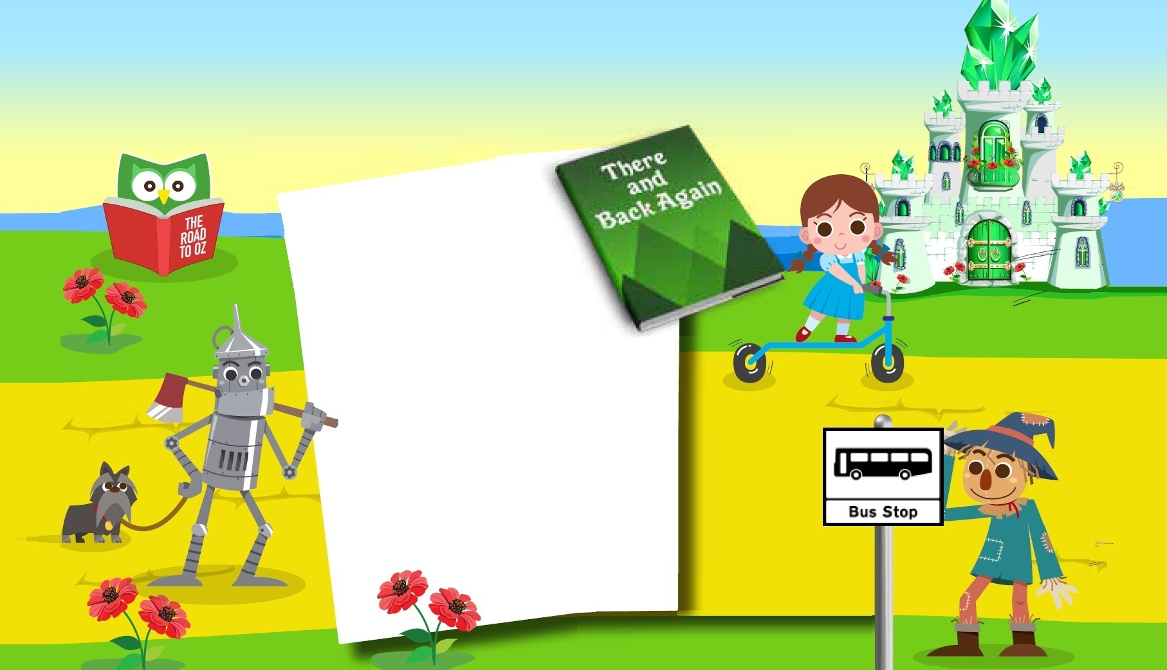
Share stories about friendship
Share stories about friendship on Stayed Connected Monday.
Travelling to school
together by
walking, wheeling, cycling, scooting, car sharing or catching the bus
are great ways to connect with others!
Who you see along the way?
Which story are you
going to share with them?

Slide 5

Create poetry in Motion
Create Poetry in Motion on Move More Tuesday.
Write an acrostic poem about the active way you Travel Smart on your school journey.
An acrostic poem is a type of poetry where the first letter of each line spells out a word or name when read from top to bottom.
Click goes the helmet, pedals ready to spin
You’re off to school, riding with a big grin
Chain clicking, cycle bell rings as you ride
Legs power on, until the down hill glide
Enjoy the journey and Travel Smart with pride!

Slide 6
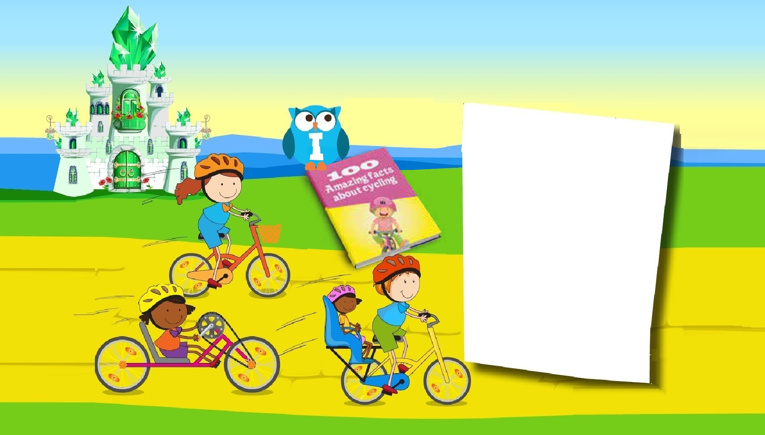
Discover interesting facts
Discover Interesting facts in non-fiction books
on Wonder Wednesday.
Find out 5 amazing facts about a
Travel Smart way to make a school journey.
You could find out about when a type of transport was invented,
or how travelling smart is healthy for you and the planet.
Did you know,
not all cycles have two wheels and are pedal powered?

Slide 7
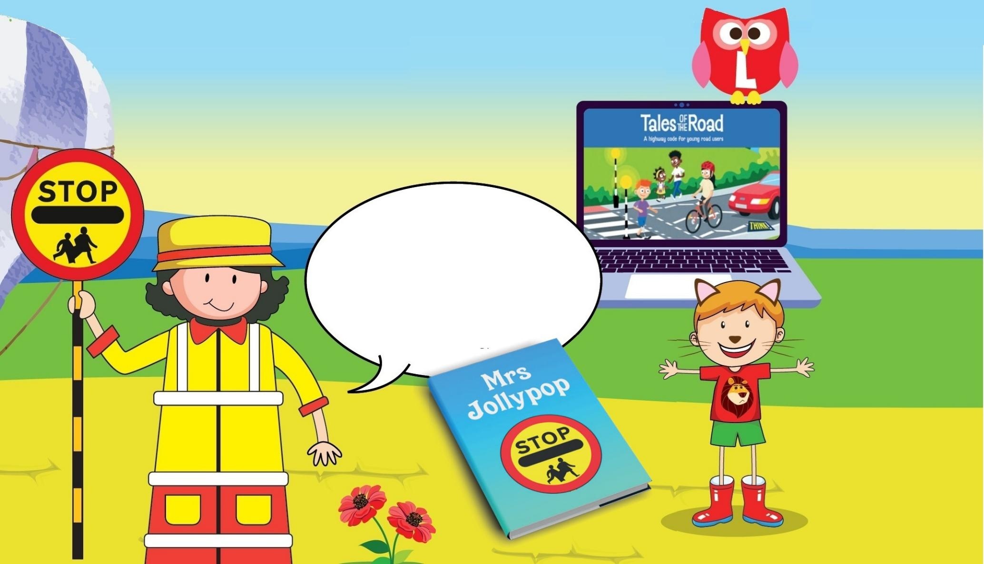
Look and Listen
Look and Listen Thursday.
Learn how to use all of your senses
with Tales of the Road
to help keep you safe on your school journey.
Visit www.think.gov.uk/ resource/tales-of-the road/
to find out more about travelling safely when you’re walking, cycling, in the car
and on the bus.

Slide 8
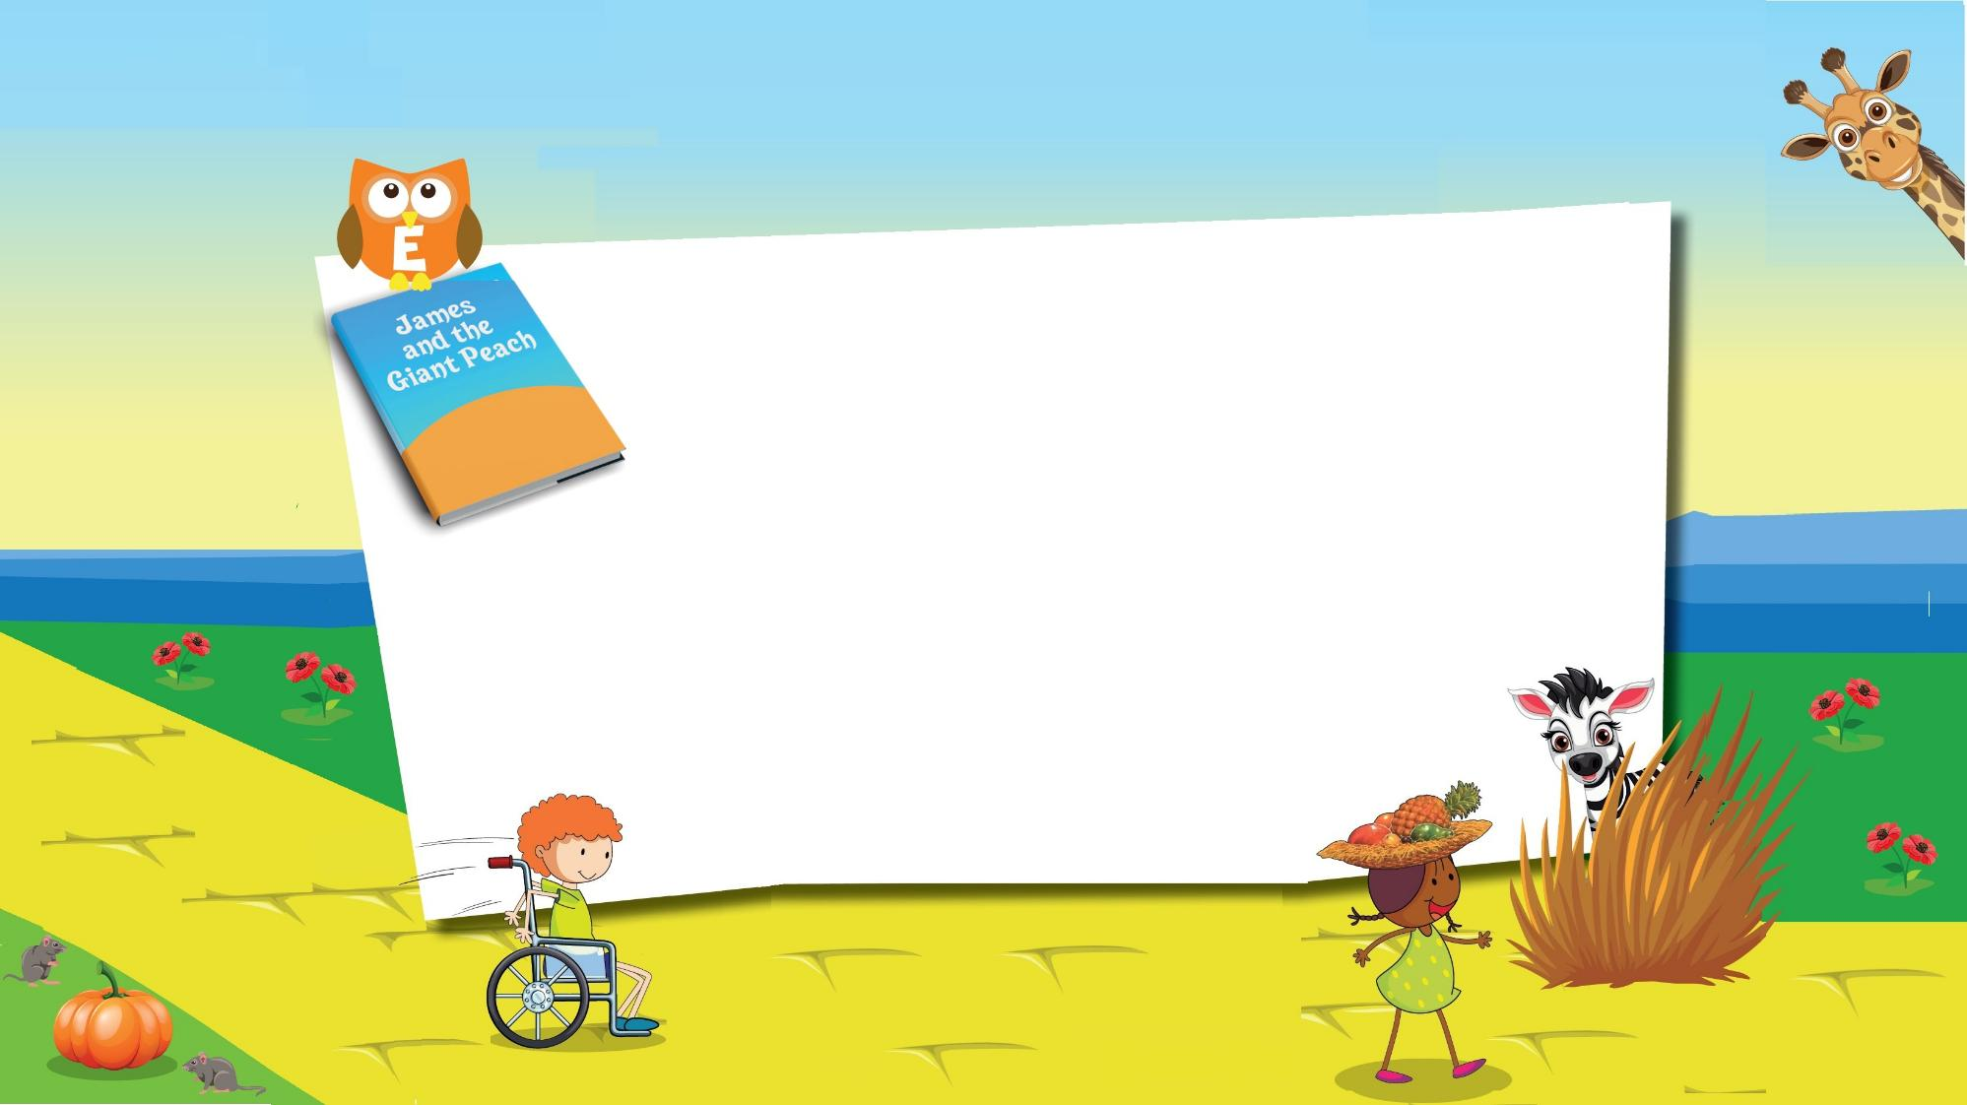
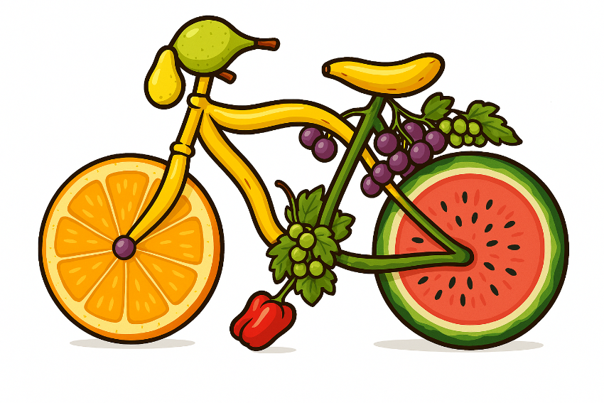
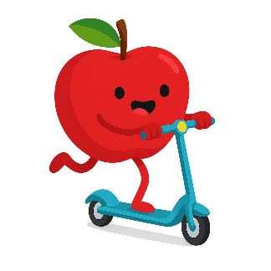
Eat well
Eat Well on a Fruit Fuelled Friday.
Give yourself an energy boost on your school journey.
Which delicious fruit would you like to eat as you Travel Smart?
Can you image fruit walking, wheeling, cycling, or scooting
or even as a mode of transport?

Slide 9




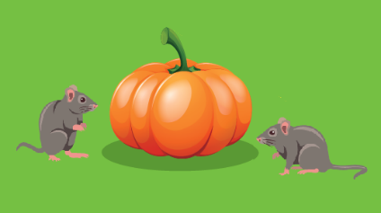
Spot the story
Did you spot all the stories?
The Road to Oz
is one of a series stories by L. Frank Baum about a girl called Dorothy and her journey along a yellow brick road.
There And Back Again is
the subtitle to The Hobbit about a journey in search of dragon guarded gold!
This rhyming story, by Dr Seuss,
is about feeling okay,
when things in life
don’t go your way!
The Jolly Witch Trilogy by Dick King Smith features a story about a magical crossing patrol sign.
Did you also see the
fruit basket from
Handa’s Surprise
and
the pumpkin coach from Cinderella?
This is a story by Roald Dahl about a boy's journey to New York City on a giant peach.

Slide 10


Get in touch
We’d love to hear from you!
If your school is on Facebook please share your book recommendations, drawings, poems, and interesting facts with us.
You can find us at
www.facebook.com/travelsmartderbyshire/

Slide 11
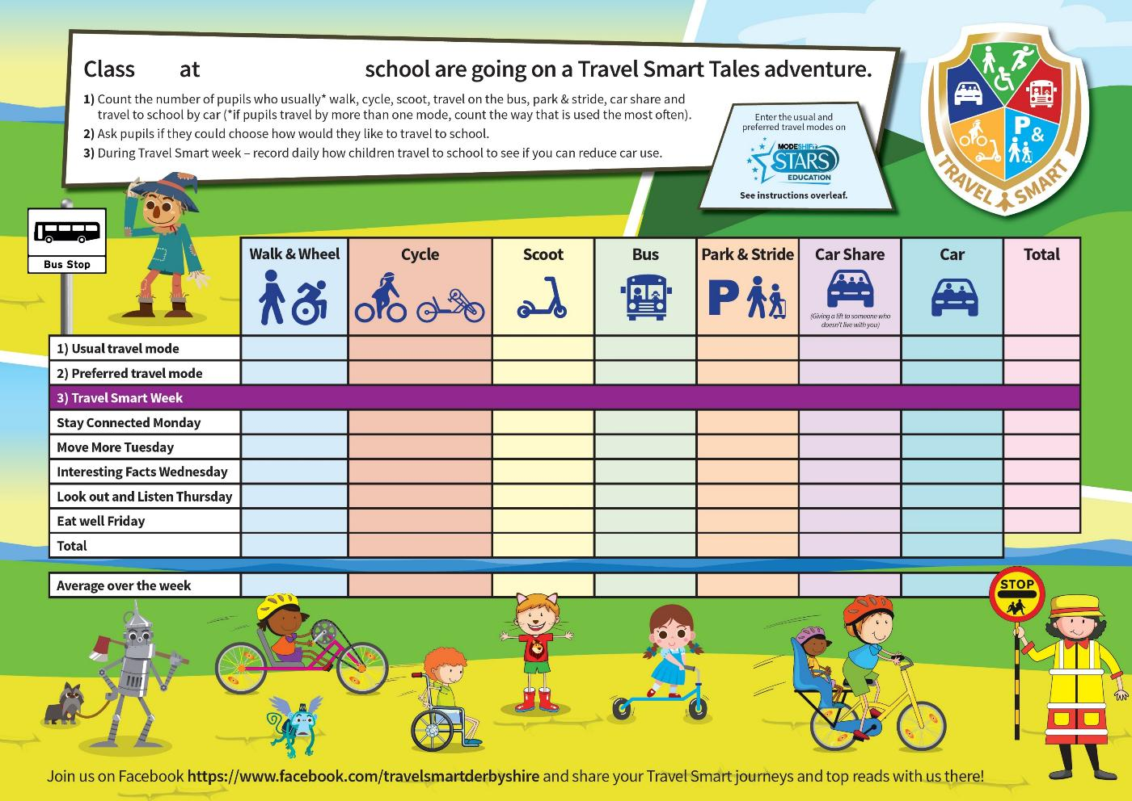
Don’t forget to record your journeys
Finally –
remember to record
how you usually travel to school and how you would like to travel.
Then compare this with how you make your journey in Travel Smart week to see if there’s a difference
that you can keep up
all the time!

