Slide 1

The Art of Travel Smart
Get active and arty on your school journey to explore how you can boost your wellbeing
through the power of walking, wheeling, cycling, scooter gliding, bus or carshare riding
or Park & Striding!
Follow the SMILERS owls to discover and be inspired by different artists to create Travel Smart art of your own.
The Art of
Travel Smart
19th – 23rd October 2026

Slide 2

Smilers Ways to Wellbeing
The SMILERS Ways to Wellbeing
Stay Connected. Having healthy relationships with people, pets and nature to help you to feel happy.
Move. Being active releases chemicals in your brain which boosts your mood and makes you feel good.
Interest. Having special interests and learning something new to help keep your brain busy.
Look. Using your senses to notice what is around you to keep you in the moment.
Eat well. Eating a balanced diet to make you feel good and help you stay healthy and strong.
Rest. Getting a good night’s sleep to improve your memory, mood and mental health.
Support. Supporting others to make us feel positive and to make them happy too!

Slide 3


Ways to make a journey
Ways to Travel Smart
for a happier, healthier, safer, cleaner and greener school journey!
Walk or Wheel
Choose your move and follow the SMILERS on an arty Travel Smart journey!
Carshare
Bus or Train
Cycle or Scoot
Park and
Stride or Glide

Slide 4

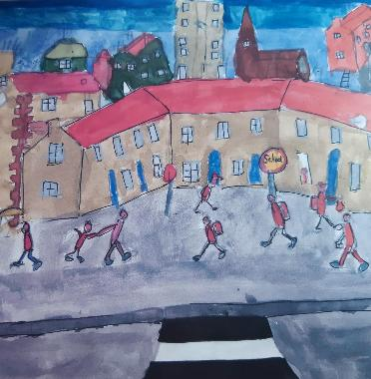
Monday
Having healthy relationships with people, pets
and nature helps you feel happy.
The artist Lowry was famous
for drawing stick like people.
Draw your school journey in the style of Lowry’s picture ‘The Schoolyard’.
Who do you make your school journey with?
Who do you see
on the way?

Slide 5


Tuesday
Being active releases chemicals
in your brain which boosts your
mood and makes you feel good.
Calligrams are words arranged
in a shape or pattern that matches
what they are describing.
Create a calligram of how you like to move on your school journey.

Slide 6

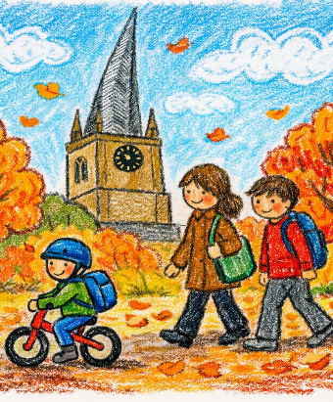
Wednesday
Explore the landscape and buildings on your school journey and make, or take, a picture of the interesting things you see.
Having special interests and learning something new helps keep your brain busy.
‘Treasured Times’, by artist Lucy Pittaway,
is inspired by her memories of teaching her twins how to ride bikes and exploring the outdoors.

Slide 7
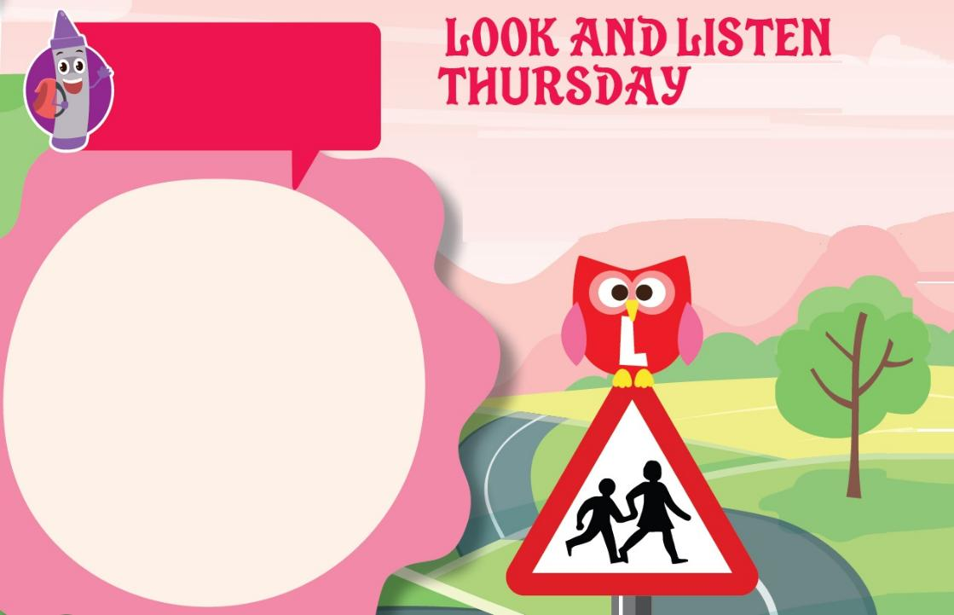

Thursday
Margaret Calvert is the designer who created the images on lots of road signs.
Using your senses, to notice what is around you, helps to keep you in the moment.
Design a road sign to give a message
about keeping healthy and safe outside your school.

Slide 8
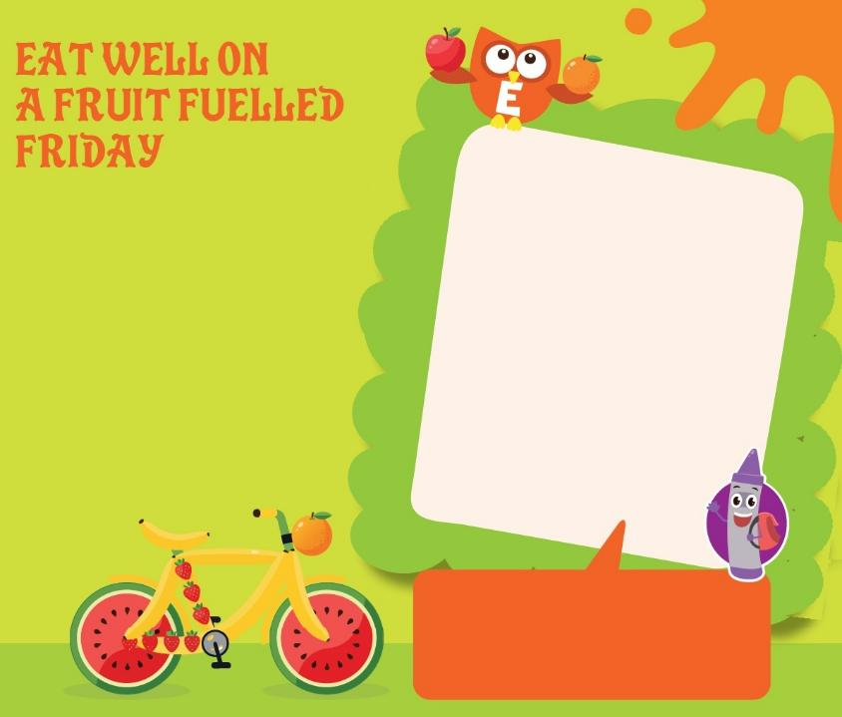
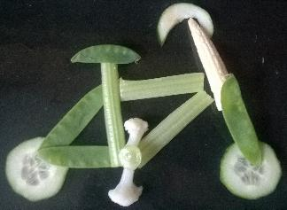
Friday
Fruit and vegetables are part of a healthy, balanced diet. It’s important that you try to eat enough of them to help you stay healthy and strong.
Check out the recipes at
https://www.nhs.uk/healthier-families/recipes/
Can you use
everyday objects or even fruit and vegetables
to make up a mode of travel or even a SMILERS owl?
Italian artist
Giuseppe Arcimboldo
was famous for creating portraits using fruit and vegetables.

Slide 9

Pavement smart
Remember to Travel Safe when you Travel Smart!
Be Pavement Smart.
Remember to stop, look and listen when you cross the road.
If there one available, use a zebra, light controlled or school crossing patrol to help you.
If you are scooting on the pavement look out for each other as well as other walkers and wheelers.

Slide 10

Smart Wheeler
Remember to Travel Safe when you Travel Smart!
Be a Smart Wheeler.
Make sure you and your wheels are safe to roll, check your brakes steering and tyres.
If you are scooting or cycling think about wearing a helmet.
Take care near driveways and look out for other pavement users.

Slide 11

Smart passenger
Remember to Travel Safe when you Travel Smart!
Be a Smart Passenger.
Always listen to the driver when they ask you to use a car seat or seat belt to help keep you safe.
Don’t distract the driver by messing about with other passengers.
Be aware of other vehicles when getting off the bus or out of the car.

Slide 12

Park Smart
Remember to Travel Safe when you Travel Smart!
Park Smart.
Remind the driver not to stop or park on the yellow zig zag lines. Park away from school and walk or wheel the last distance if you can.
Remind the driver not to park on the pavement and not to block dropped kerbs and driveways.
Remind the driver to turn the engine off when waiting.

Slide 13

Share your artwork
Visit a library or use the internet to find out more about each artist or any other artist, designer, photographer, sculptor or illustrator who inspires you.
Create a Travel Smart Art ‘Post-It’ note gallery in your class or school of your favourite artist.
Ask a grown up to post your creations to us at
www.facebook.com/travelsmartderbyshire with #TravelSmartArt
or email it to sustainable.travel@derbyshire.gov.uk

Slide 14
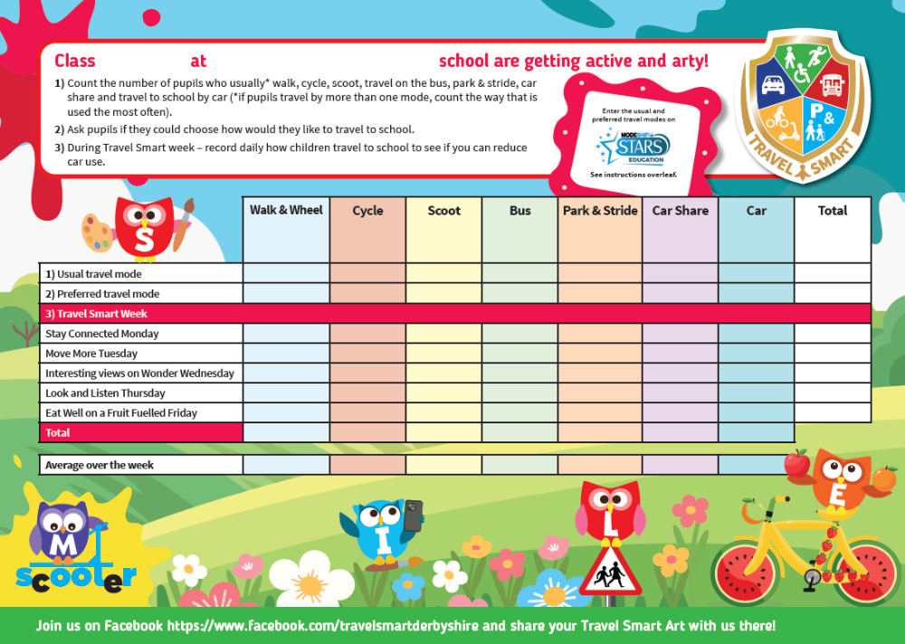

Remember to record how you travel
Remember to record how you usually travel to school and how you would like to travel.
Then compare this to how you make your journey in Travel Smart week to see if there is a difference.

Slide 15
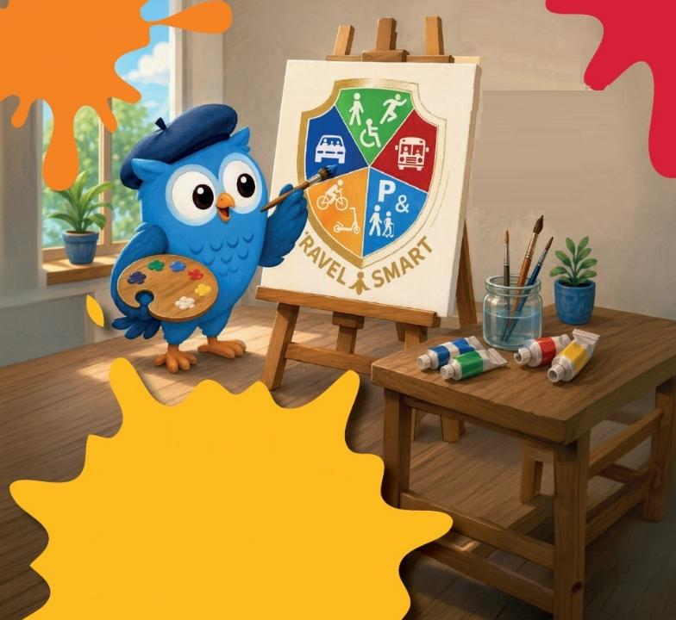
Have a great Art of Travel Smart week
Have a great
Art of Travel Smart
Week!

